Slide 1
End to End ML and AI
QUBIT

Slide 2
Introduction to ML
The Black Box Example

Slide 3

x^{(i)}
y^{(i)}
1
2
2
4
3
6
4
8
5
10
f(x)

Slide 4
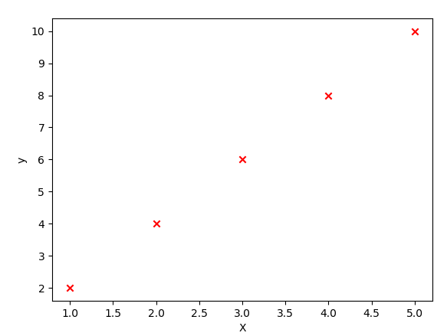
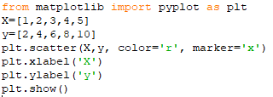

Slide 5
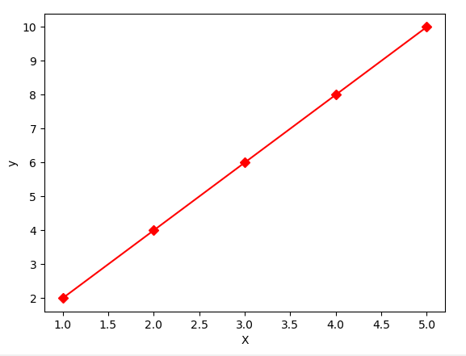
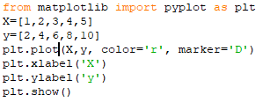
y= 2x+0

Slide 6
x^{(i)}
y^{(i)}
1
2
2
4
3
5
4
9
5
12
f(x)

Slide 7
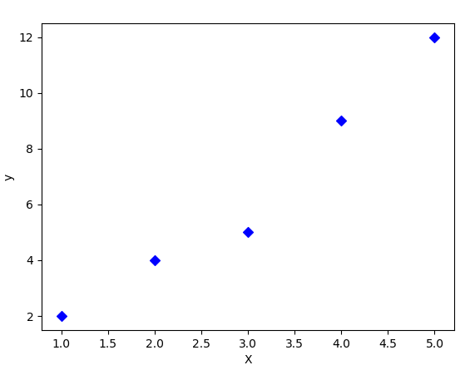
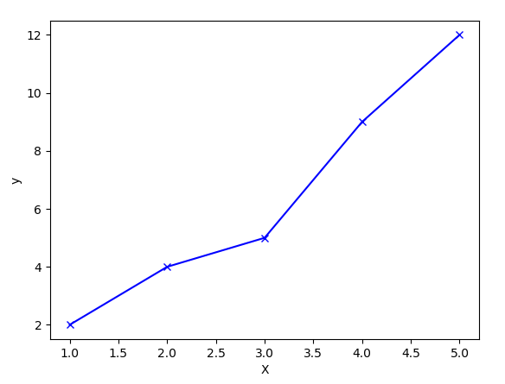
y= mx+c,
m=?? and c=??

Slide 8
y= 𝛳₀ + 𝛳₁x
Let, 𝛳= [𝛳₀ 𝛳₁]^{T}
X= [1 x]^{T}
y= 𝛳^{T}X

Slide 9
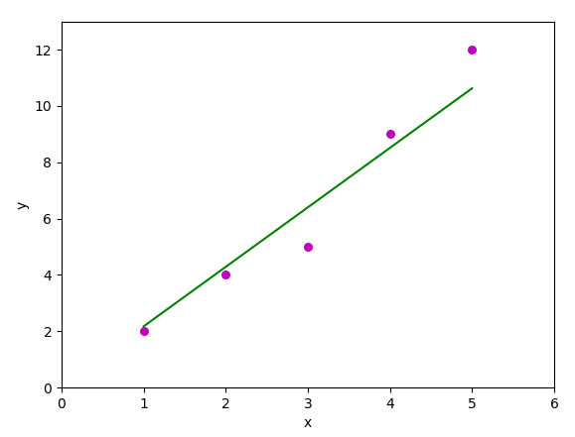
𝛳= [𝛳₀ 𝛳₁]^{T}
where,
𝛳₀ = -1.1
𝛳₁ = 2.5
y= 𝛳^{T}X
= -1.1 + 2.5x

Slide 10
Error function or Cost function
h(x^{(i)})= 𝛳₀ + 𝛳₁x^{(i)}
y^{(i)} is given (by the scatter points)
J(𝛳) = 1/2m (𝚺_{i=1 to n}(h(x^{(i)})- y^{(i)})²)

Slide 11

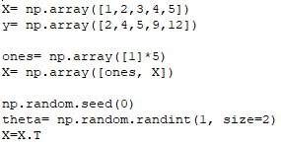


Slide 12
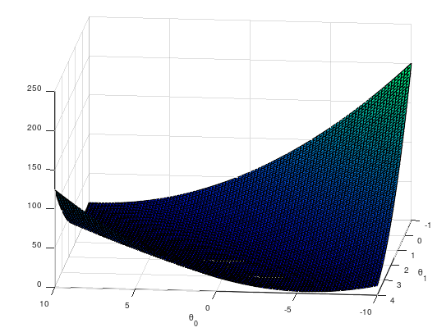
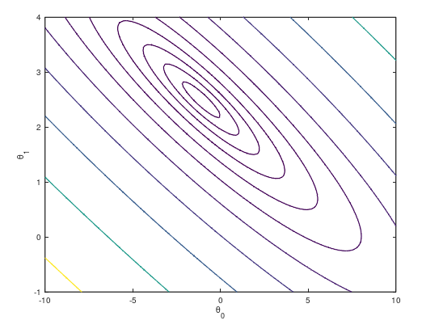

Slide 13
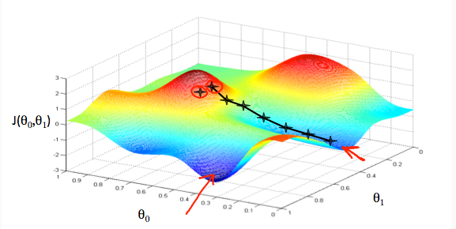
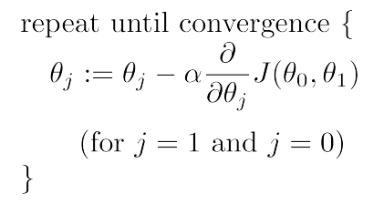
Finding 𝛳 using Gradient Descent algorithm
min(𝛳₀, 𝛳₁) J(𝛳₀, 𝛳₁)
where J(𝛳)= 1/2m (𝚺_{i=1 to n}(h(x^{(i)})- y^{(i)})²)
Start with i =1 and update 𝛳 till i=n,

Slide 14

Gradient Descent Intuition
Lets work this out for j=0 and j=1, that is, for 𝛳₀ and 𝛳₁

Slide 15
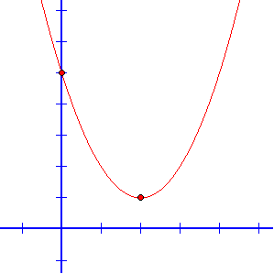
Gradient Descent Intuition
2 Cases:
For d/d(𝛳₁) J(𝛳₀, 𝛳₁) > 0
𝛳₁ = 𝛳₁ - 𝞪 where 𝞪 > 0
For d/d(𝛳₁) J(𝛳₀, 𝛳₁) < 0
𝛳₁ = 𝛳₁ - 𝞪 where 𝞪 < 0

Slide 16
Linear Regression Summarised

Slide 17
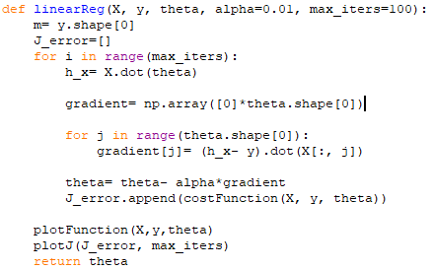

Slide 18
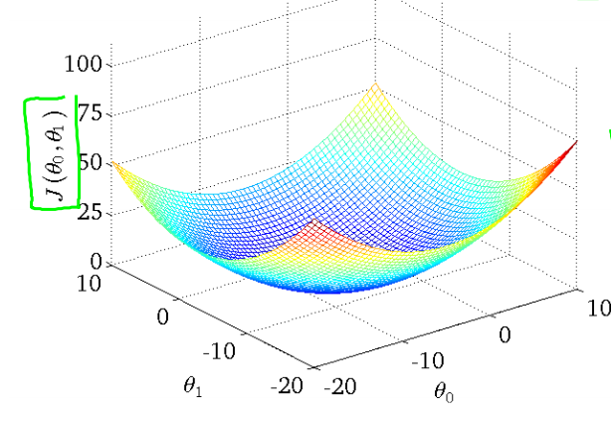

Slide 19
Multi-linear Regression

Slide 20
x₁^{(i)}
x₂^{(i)}
y^{(i)}
2
1
3
4
2
4
5
3
7
9
4
9
f(x)
12
5
10

Slide 21
y= 𝛳₀ + 𝛳₁x₁+ 𝛳₂x₂
Let, 𝛳= [𝛳₀ 𝛳₁ 𝛳₂]^{T}
X= [1 x₁ x₂]^{T}
y= 𝛳^{T}X

Slide 22
Error function or Cost function
h(x^{(i)})= 𝛳₀ + 𝛳₁x₁^{(i)}+ 𝛳₂x₂^{(i)}
y^{(i)} is given (by the scatter points)
J(𝛳) = 1/2m (𝚺_{i=1 to n}(h(x^{(i)})- y^{(i)})²)

Slide 23
Gradient Descent and other steps, the same.

